Slide 1
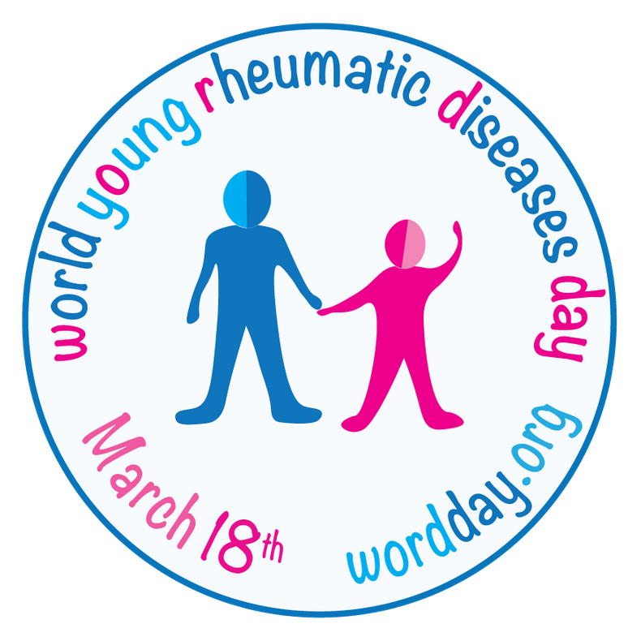
World
yOung
Rheumatic
Diseases day
18 March 2020

Slide 3
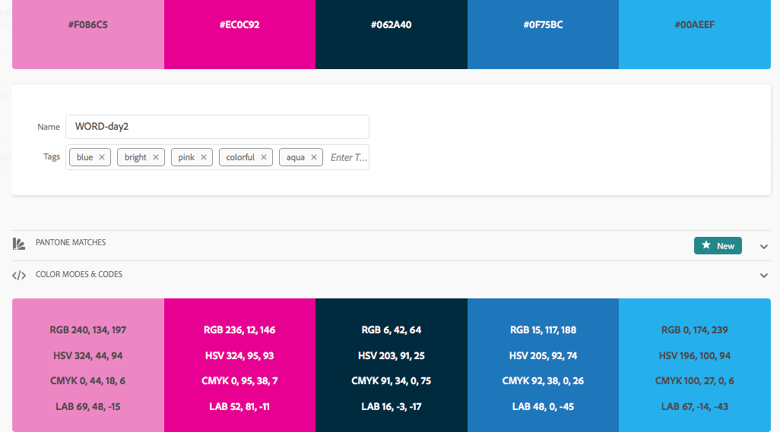
Kleurcodes

Slide 4
world young rheumatic diseases day
18 March 2020
the
burden of disease
is often underestimated
Early diagnosis and treatment changes lives
parents are key to children's wellbeing and health
Children get rheumatic diseases
too
siblings need support too

Slide 5
children
get rheumatic diseases too

Slide 6
children get rheumatic diseases
too

Slide 7
young people get rheumatic diseases too

Slide 8
young people get rheumatic diseases
too

Slide 9
early diagnosis and treatment changes lives

Slide 10
parents are key to children's wellbeing and health

Slide 11
the burden of disease
is often underestimated

Slide 12
parents are key to children's wellbeing and health

Slide 13
the
burden of disease
is often underestimated

Slide 14
the burden
of disease
is often
under-
estimated

Slide 15
siblings need support too

Slide 16
siblings need support too

